Slide 1

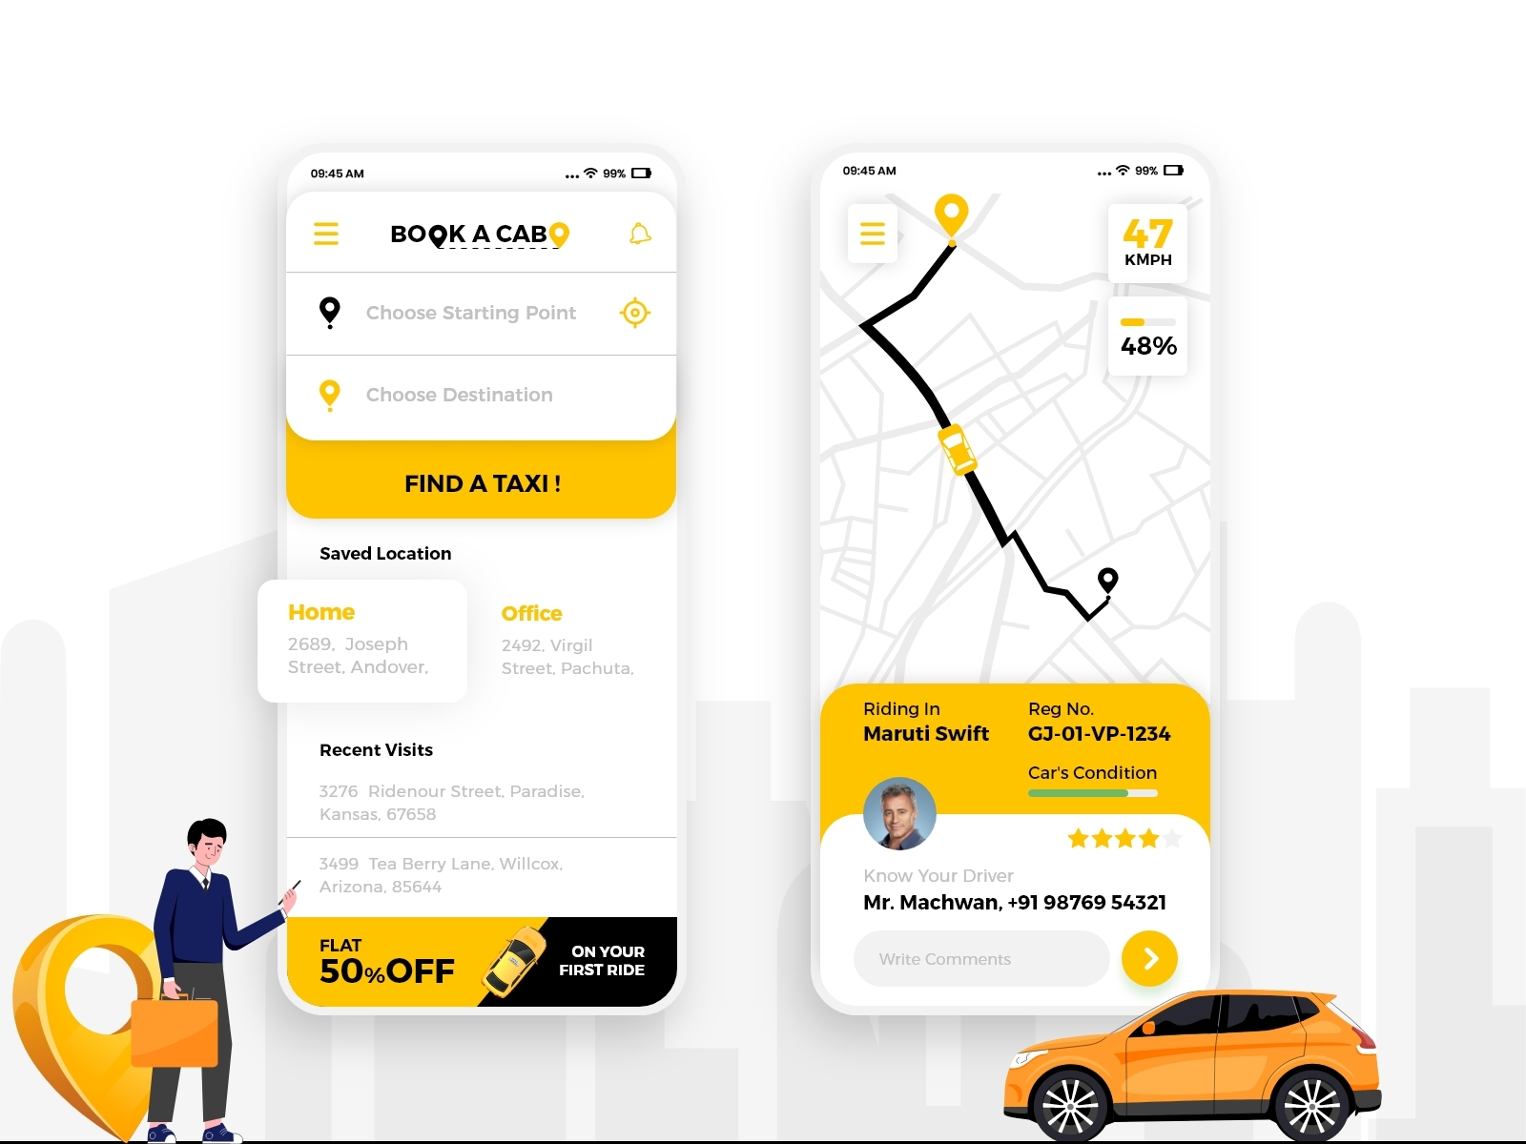


Ride Compare Pro: Empowering Informed Transportation Decisions
The objective of Ride Compare Pro is to empower users by providing a comprehensive platform that compares transportation options across multiple service providers, allowing them to make informed decisions based on fare, convenience, and availability. The goal is to simplify the process of finding the most cost-effective and suitable travel option, whether it's a cab, bus, or other forms of transportation, by offering real-time fare comparisons, route options, and booking integration.

Slide 2


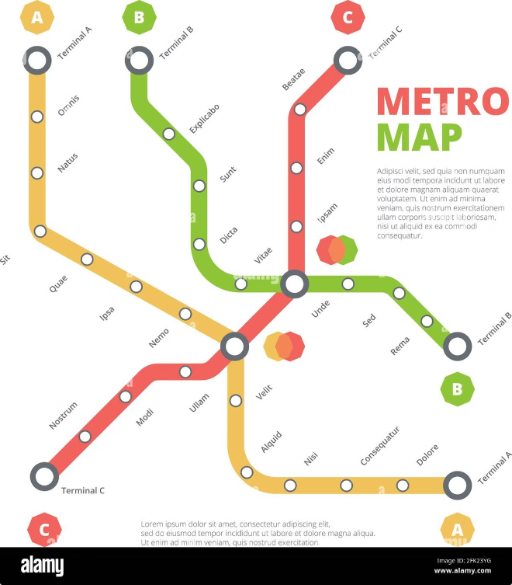
Comprehensive Platform for Fare, Convenience, and Availability Comparisons
1
Fare Comparison
2
Convenience Evaluation
Ride Compare Pro compares real-time fares across a wide range of service providers, including cabs, buses, and other transportation options.
The platform considers factors like pick-up and drop-off locations, estimated travel time, and availability of seats or vehicles.
3
Availability Check
4
User-Friendly Interface
Ride Compare Pro displays real-time availability for each transportation option, allowing users to book their ride instantly.
Ride Compare Pro offers a simple and intuitive interface, making it easy for users to navigate and find the best transportation option.

Slide 3

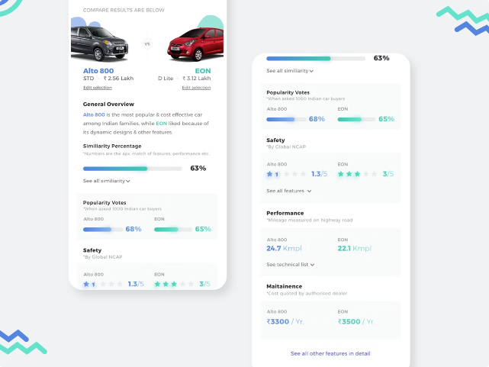
Real-Time Fare Comparisons Across Multiple Service Providers
Provider
Fare
Estimated Time
Availability
OLA
$15
10 mins
Yes
Uber
$18
15 mins
Yes
Rapido
$10
20 mins
Yes

Slide 4

Competitive Landscape: Navigating the Market
Competitor
Key Features
Strengths
Weaknesses
App 1
Fare comparison, route planning
Wide provider coverage
Limited real-time updates
App 2
Real-time fare updates, discounts
User-friendly interface
Lack of route optimization
Ride Compare Pro
Fare comparison, route optimization, real-time updates, personalized recommendations
Comprehensive features, user-centric approach
New to the market

Slide 5

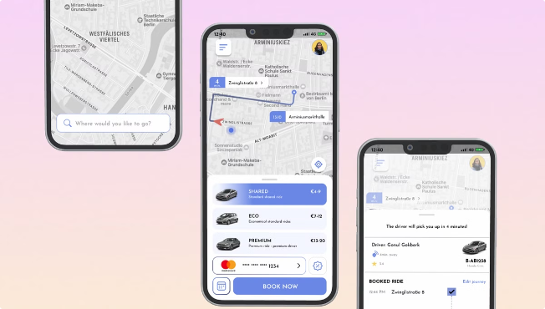



Route Options and Booking Integration for Seamless Travel Planning
Search for Rides
Enter your pick-up and drop-off locations and desired travel time.
Compare Options
View real-time fares, estimated times, and availability for each transportation provider.
Book Your Ride
Select the best option and book your ride directly through the platform.

Slide 6
Simplifying the Process of Finding the Most Cost-Effective Travel Option
Fare Optimization
Time Efficiency
Convenience
Ride Compare Pro helps users save money by finding the most affordable transportation option.
The platform saves time by providing a quick and easy way to compare options and book rides.
Ride Compare Pro eliminates the hassle of calling multiple service providers and waiting for confirmations.

Slide 7






Cab, Bus, and Other Transportation Modes Included in the Comparison
Taxi Services
Bus Services
Ride Compare Pro includes fares and availability from popular taxi companies.
The platform incorporates fares and schedules for local and regional bus services.
Ride-Sharing Services
Train Services
Ride Compare Pro provides access to fares and availability from ride-sharing platforms.
The platform compares fares and schedules for train services, including commuter lines and long-distance trains.

Slide 8


Enabling Users to Make Informed Choices Based on Their Needs and Preferences
Price
Time
Filter by price range to find options that fit your budget.
Choose your desired travel time to find the quickest or most convenient option.
Accessibility
Filter by accessibility features, such as wheelchair access or pet-friendly transportation.

